Slide 1
MITRA BHANU Rout
Mith exam
Regression

Slide 2
PROBLEM STATEMENT
Dataset consists of features of Employee. You must preict the salary of a employee. The data is collected from a train. Csv and test. Csv. First we have to predict the salary from train data set. Then compare with the test data set

Slide 3
PRE-PROCESSING STEPS FOR TRAIN:
Removing the list from the Environment.
Reading the data
Removing unique data(id,statae)
Calculating the Missing Values(11018)
Omitting the Missing Values
Finding the Structure & Summary of the data
Converting Numerical To Categorical Factors & vice versa
Handelling missing value(CNN)

Slide 4
PREPROCESSING STEPS FOR TEST
Reading the data
Removing unique data(id,exam board)
Calculating the Missing Values(2138)
Omitting the Missing Values
Finding the Structure & Summary of the data
Converting Numerical To Categorical Factors & vice versa
Handelling missing value(CNN0
Bind data

Slide 5
Models Applied:
Random Forest
Rpart

Slide 6
Accuracy in All Models:
TRAIN DATA
Random Forest :
regr.evaluation
mae mse rmse mape
5.504661e+04 1.185770e+10 1.088931e+05 1.166739e-01
mae mse rmse mape
1.139253e+05 4.138393e+10 2.034304e+05 2.616111e-01

Slide 7
RPART
#mae mse rmse mape
1.318162e+05 5.066062e+10 2.250791e+05 2.858330e-01
#mae mse rmse mape
1.442336e+05 6.661448e+10 2.580978e+05 3.190960e-01

Slide 8
Error calculation by train and test csv
RPART
mae mse rmse mape
1.092158e+06 8.041689e+11 8.967546e+05 Inf
mae mse rmse mape
#6.369291e+05 4.608780e+11 6.788799e+05 Inf

Slide 9
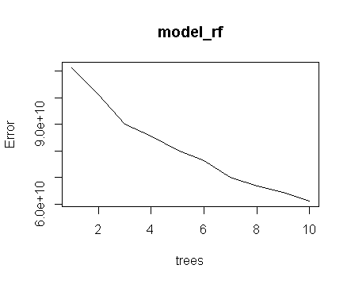
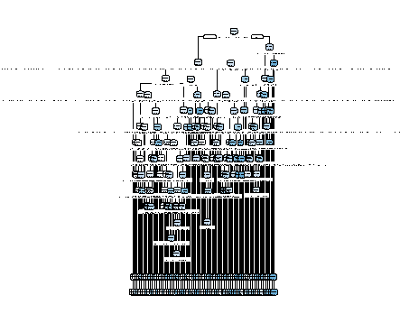
RANDOM FOREST & RPART

Slide 10
CHALLENGES FACED:
Takes too much time to run the random forest model.
Preprocessing steps are difficult.

Slide 11
CONCLUSION:
Random forest Model is preferred more because it has less error when compared to other model.

Slide 12


